Slide 1
Reactive Programming
With Spring Webflux and Reactive Mongo

Slide 2
Reactive Stream API
Publisher – Emits data
Subscriber – Receives data
Subscription
Processor (publisher +Subscriber)
Reactor – Spring webflux
Publisher – Mono, Flux
Subscriber
Subscription
Processor (pub +Sub)
Mono – 0..1 Element
Flux – 0…..N Elements
Webclient for Rest calls

Slide 3
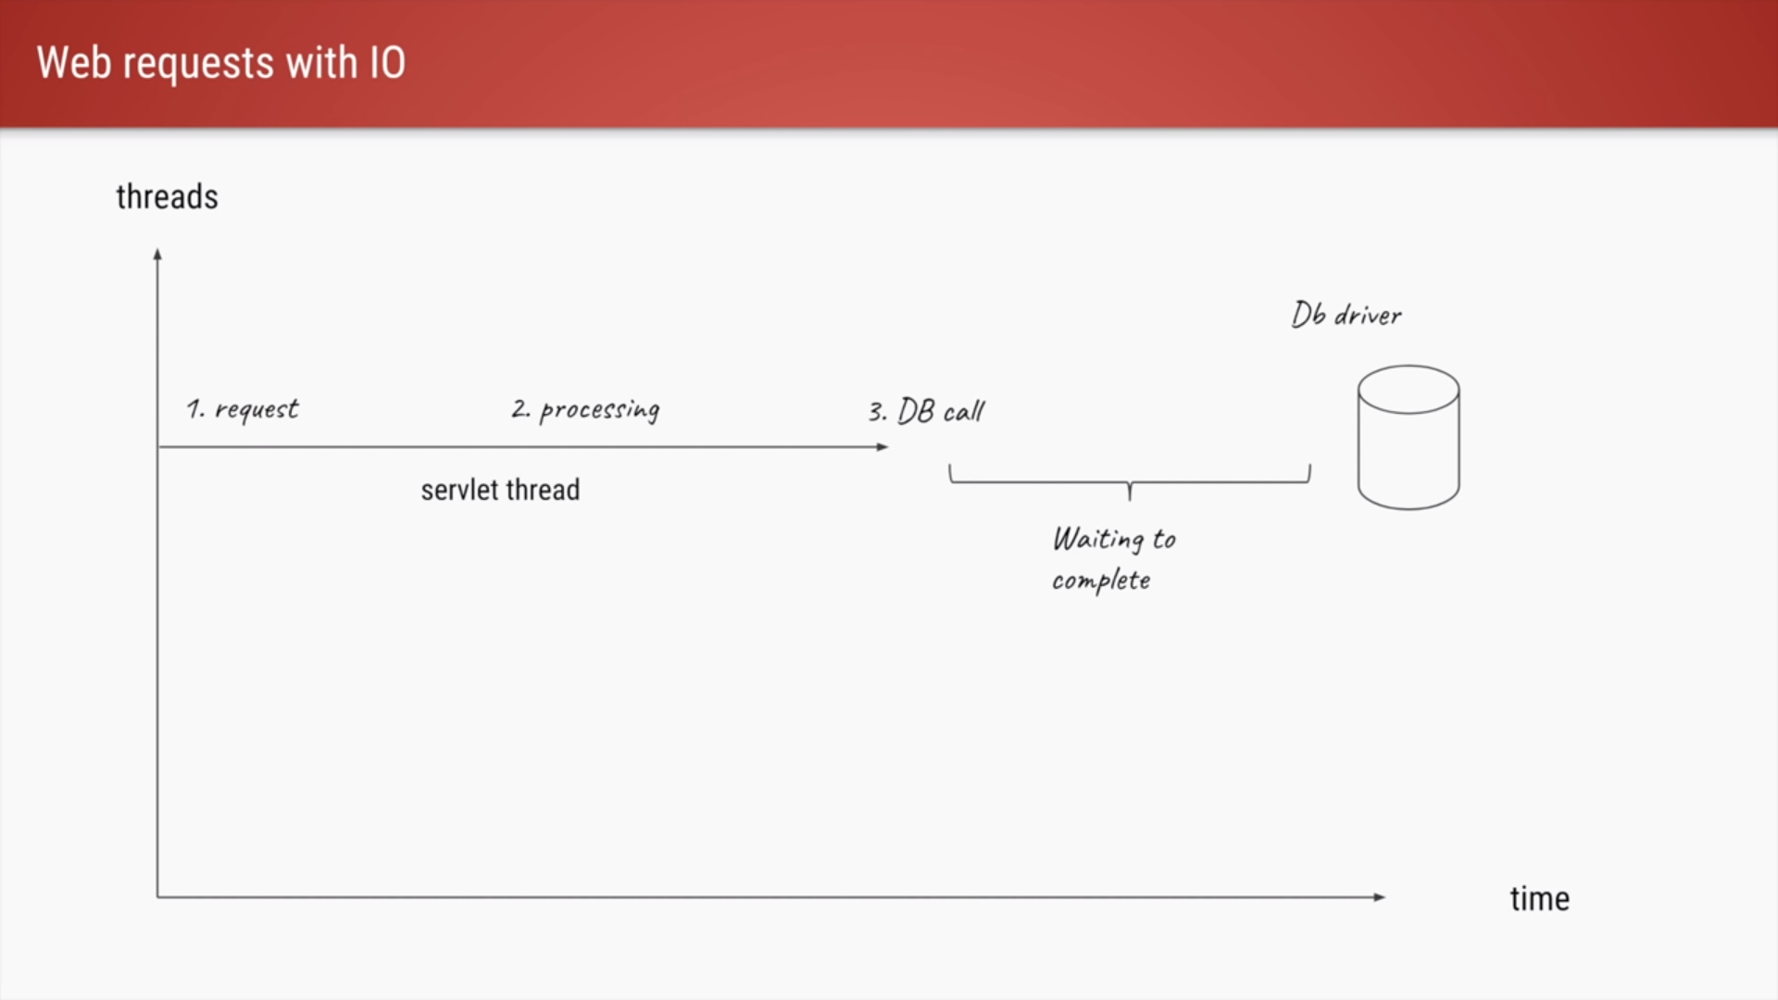

Slide 4
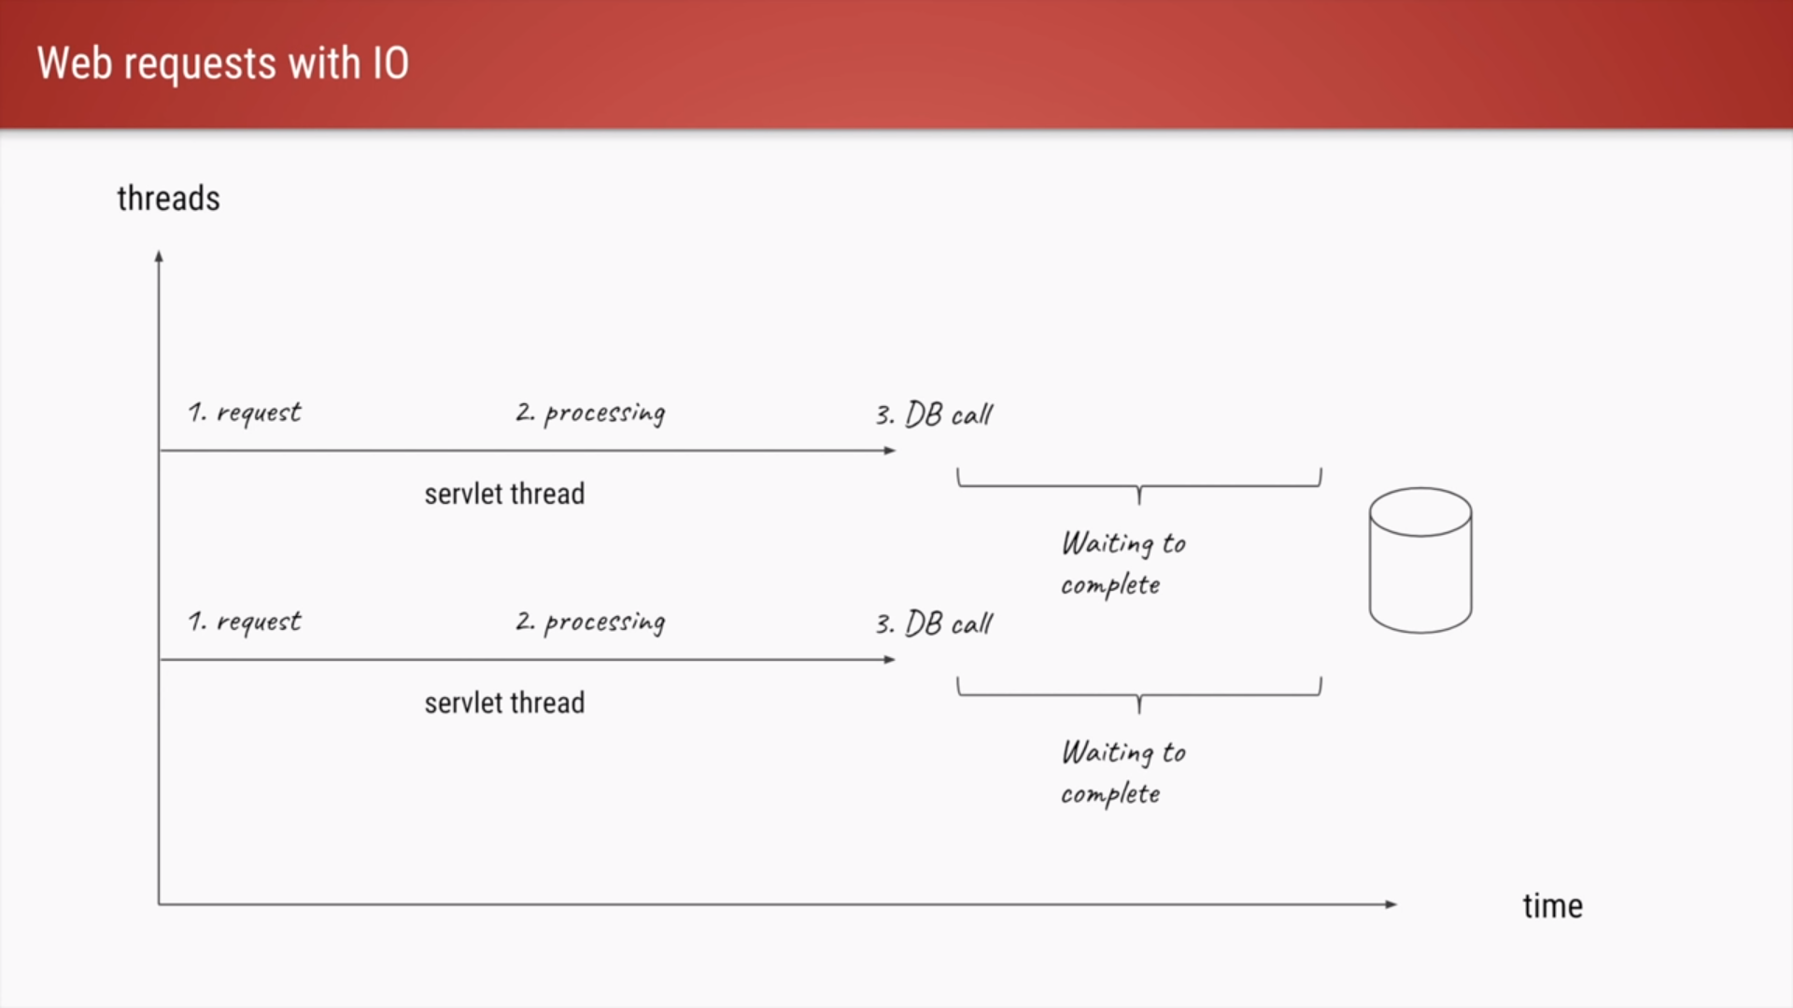

Slide 5
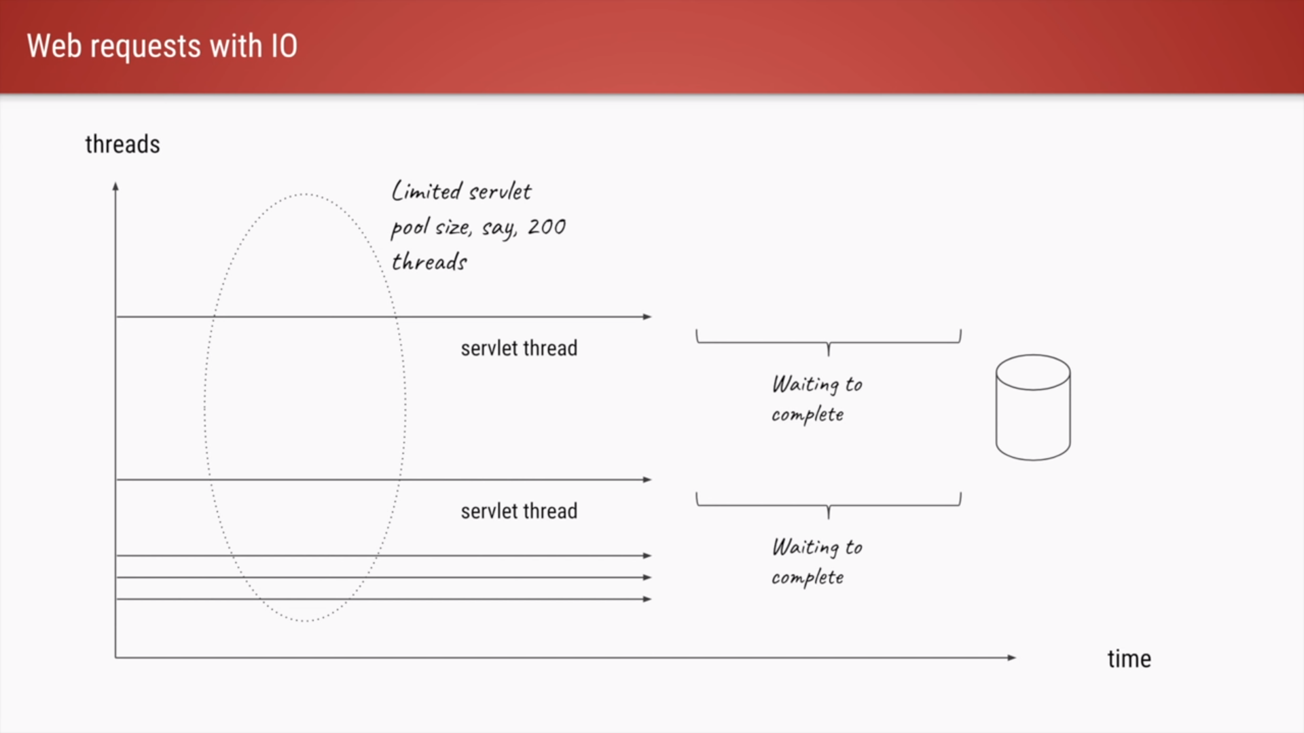

Slide 6
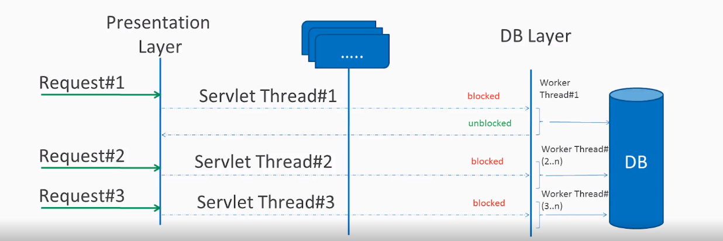
Blocking Request Processing

Slide 7
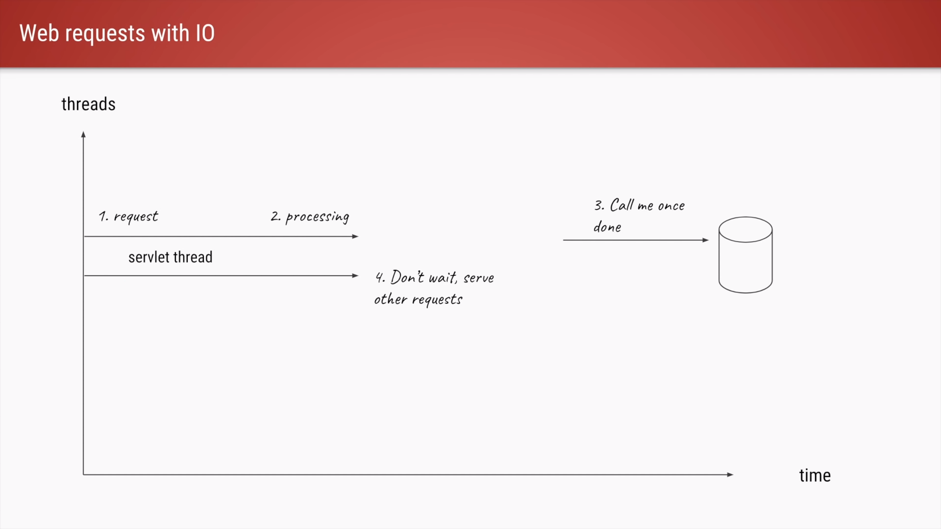

Slide 8
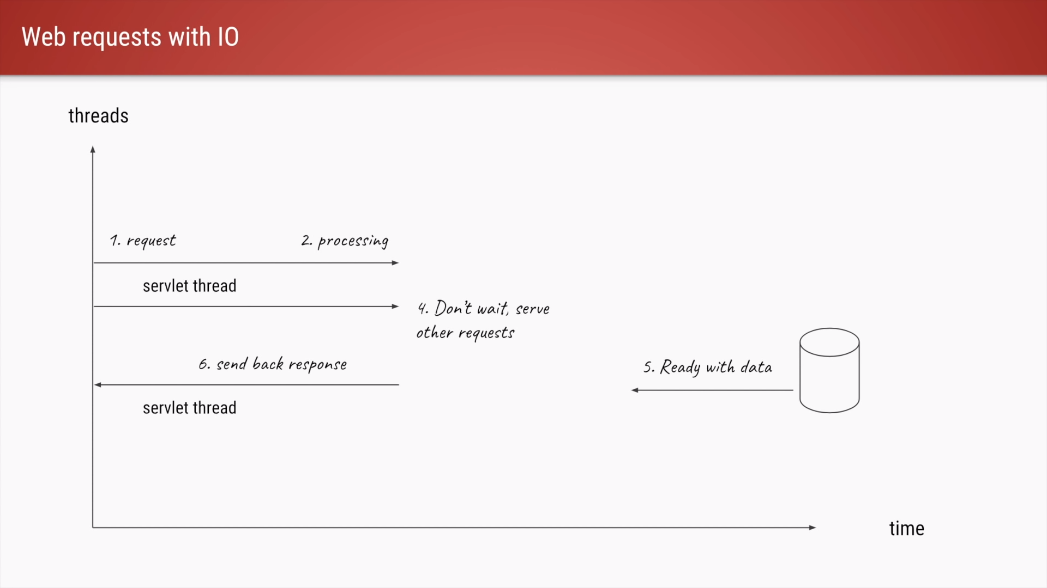

Slide 9
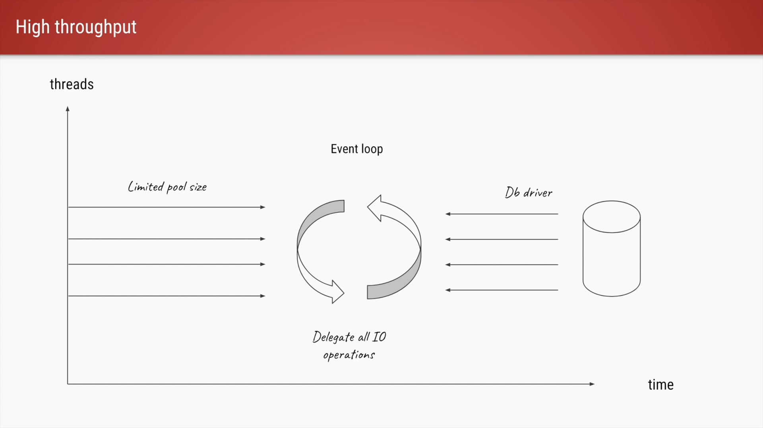

Slide 10
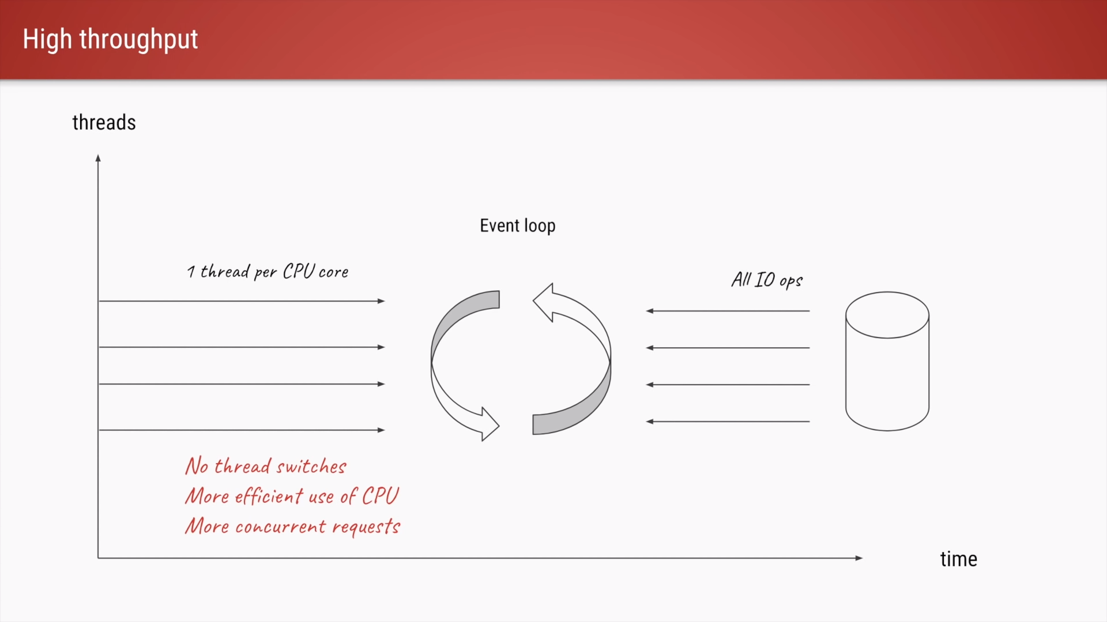

Slide 11
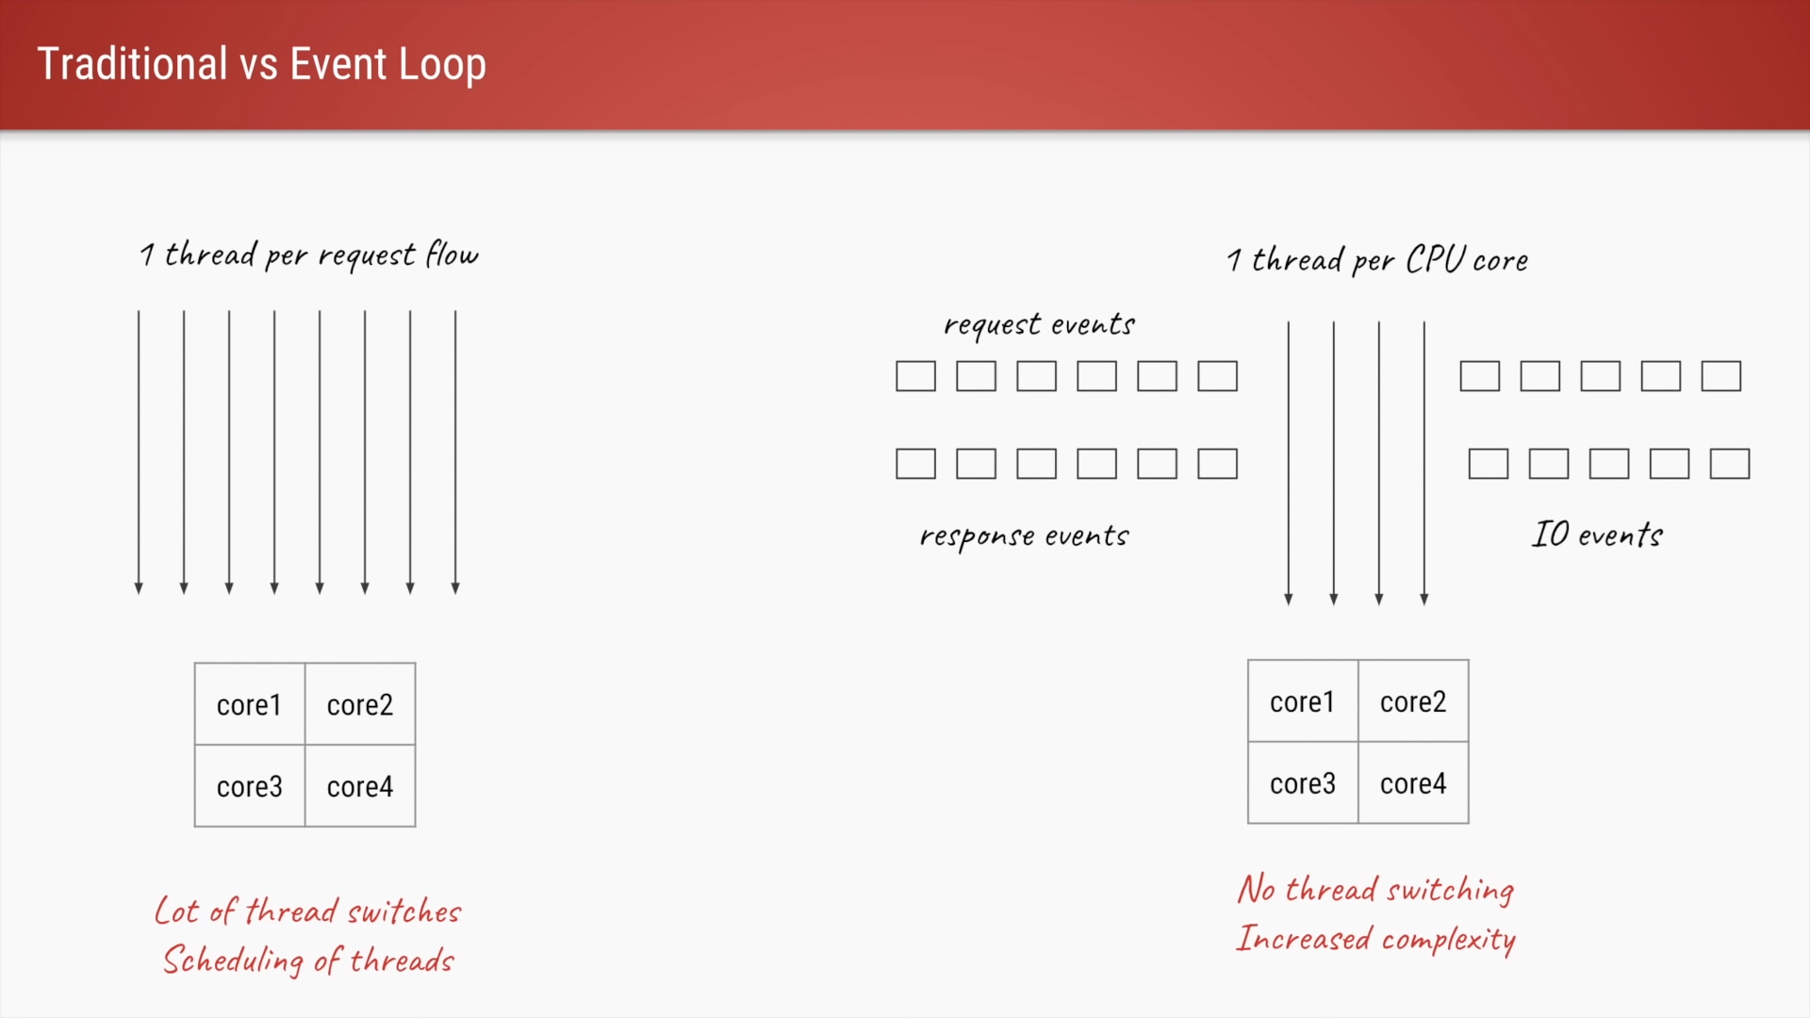

Slide 12
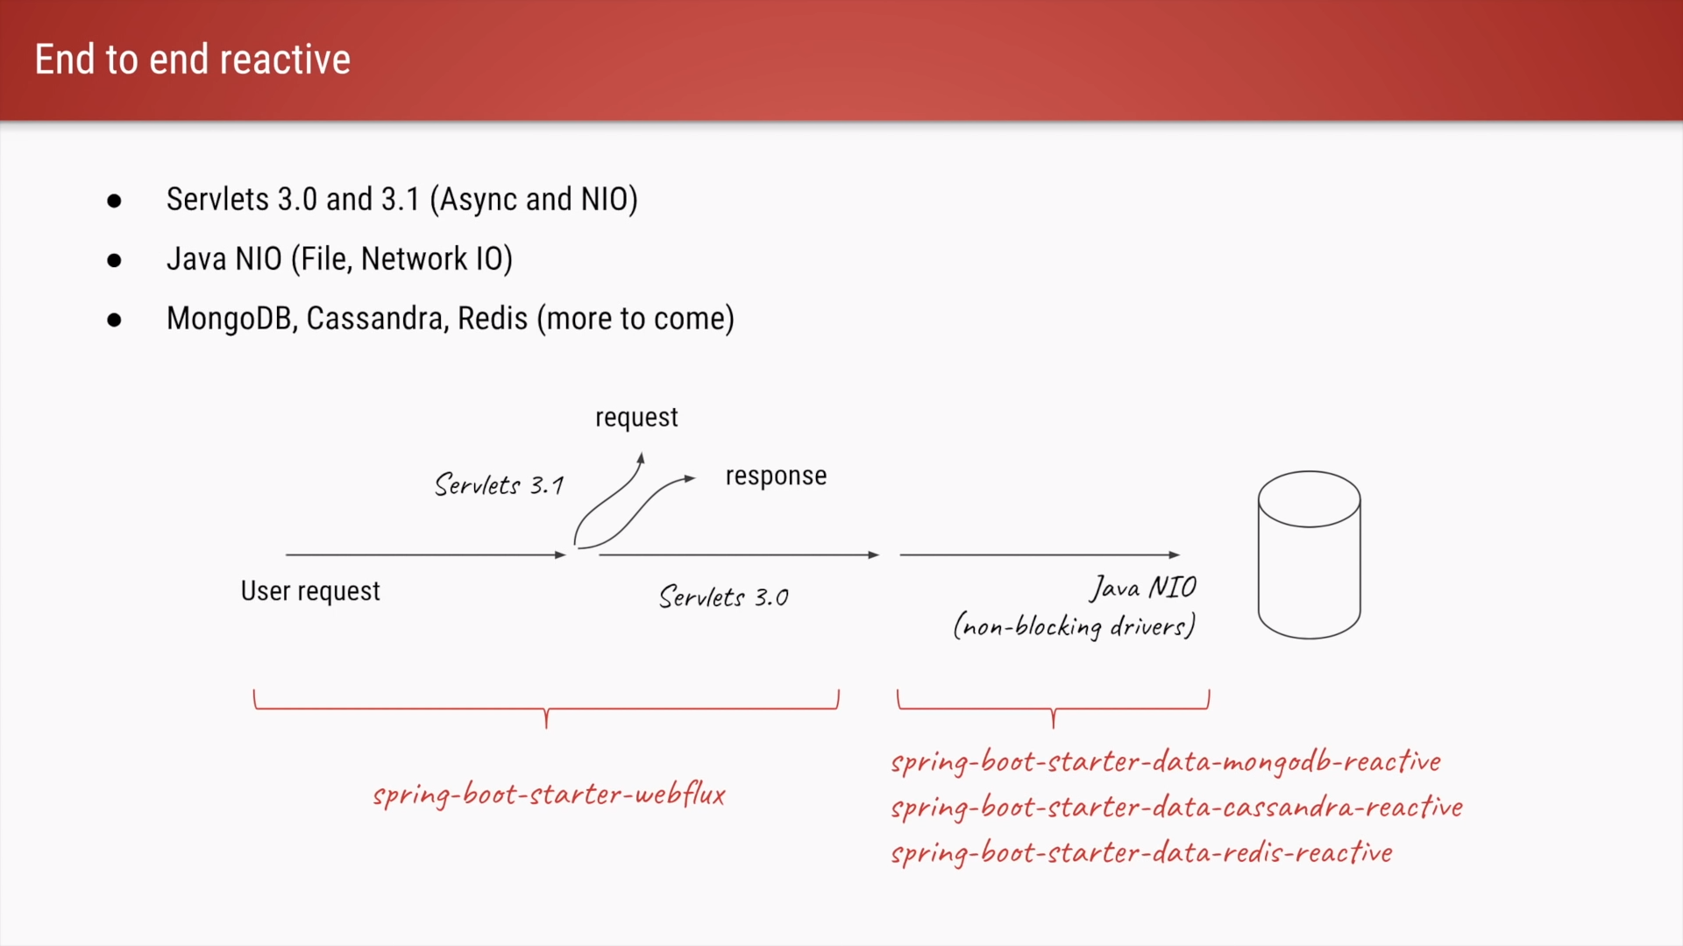

Slide 13
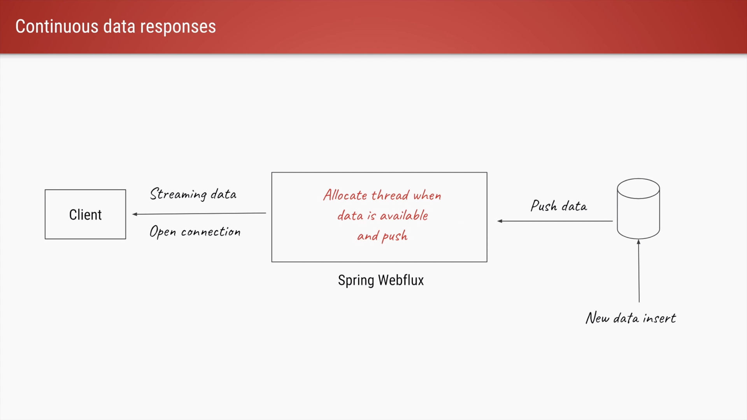

Slide 14
Advantages
Scalability
IO bound operations - Micro services
Efficient CPU utilization
Less context switches
Streaming use cases (Live stream)
Non blocking (Netty threads)
Backpressure
Considerations
Different Programming Model
End to end reactive required
Hard to debug (logging)
Hard to write test cases
Not much useful for CPU bound flows

Slide 15
Thank You…!

